Slide 1
Graphical User Interface and Data Handling for a Nuclear Quadrupole Resonance Software Defined Radio Spectrometer
WISSEN
TECHNIK
LEIDENSCHAFT
Notes:
Hello everybody,
Welcome to my Presentation of a Graphical User Interface and Data Handling for a Nuclear Quadrupole Resonance Software Defined Radio Spectrometer

Slide 2
Content:
Introduction
Method
Results
Future work
Conclusion and Q & A
Notes:
Short overview of what, I will be talking about in my praesentation.

Slide 3
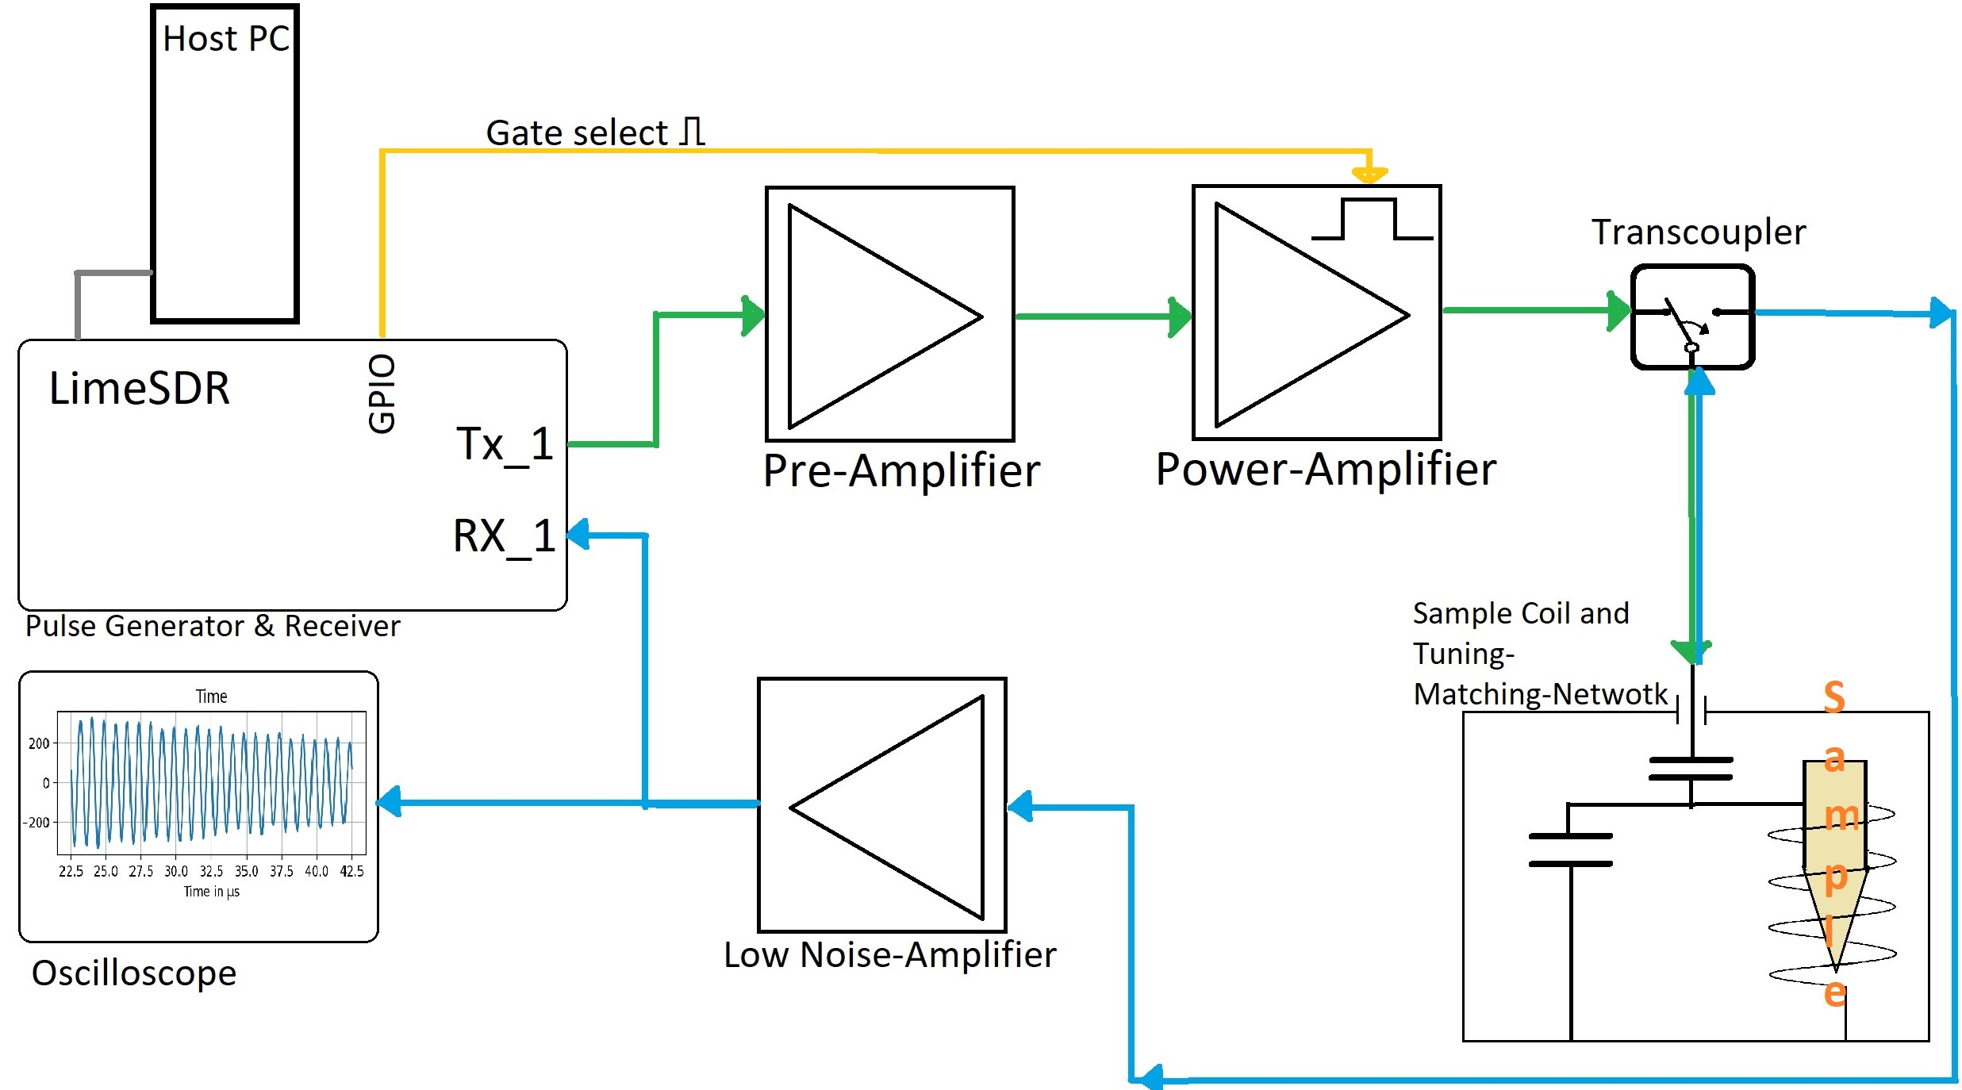
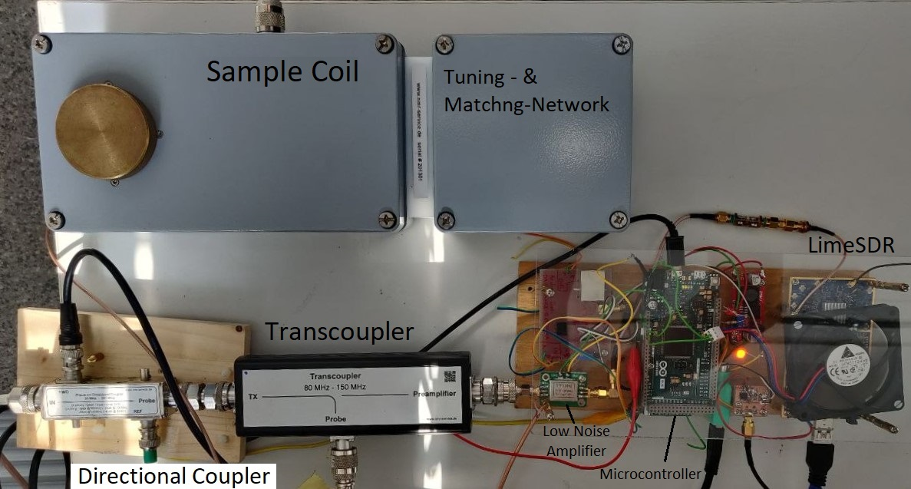
Introduktion:
Hardware setup
Signal-flow path
Notes:
The Introduction:
This is how the setup was finalised. It represents a single frequency, manual tuning and matching setup.
It starts with the Host PC and the LimeSDR. Seen in the top left coner Flowed bay a two stage amplifier a Transoupler direkts the simulus to the Sample setup. For receiving, a low Noise Amplifier is used to booste the signal sow that it can be sampled to the full scale with LimeSDR. Additionaly a Oscilloscope is used to monito the signal.

Slide 4
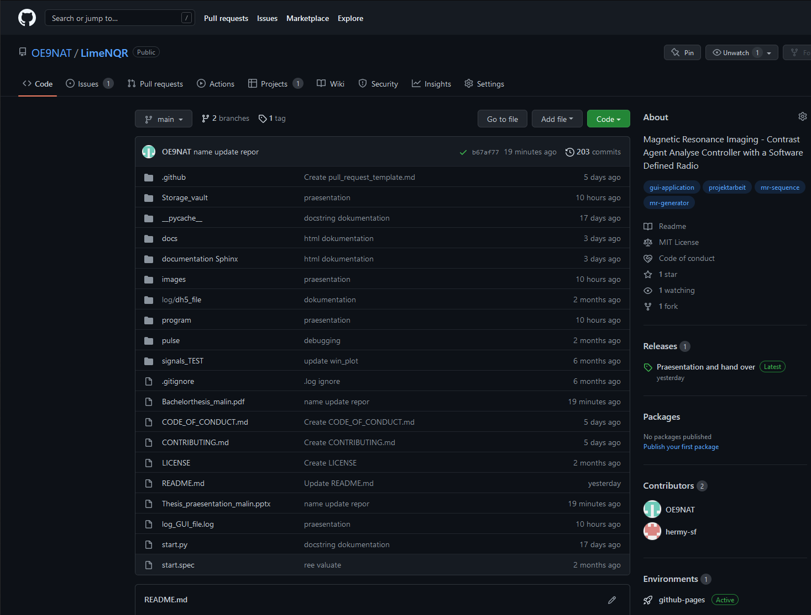
Method :
www.Github.com/oe9nat/LimeNQR
Notes:
Now comming to the Methods:
The whole projekt is pubished on my github repository. It contains all programm files and after a forking the Program can be launched localy with the start.py file. It is importand to say that the specific hardware is essential. Additionally all the dokumentation is pubilshed for the user in the wiki section, complementary for development a documentation in shinx has been written.
Further more in the comming slides

Slide 5
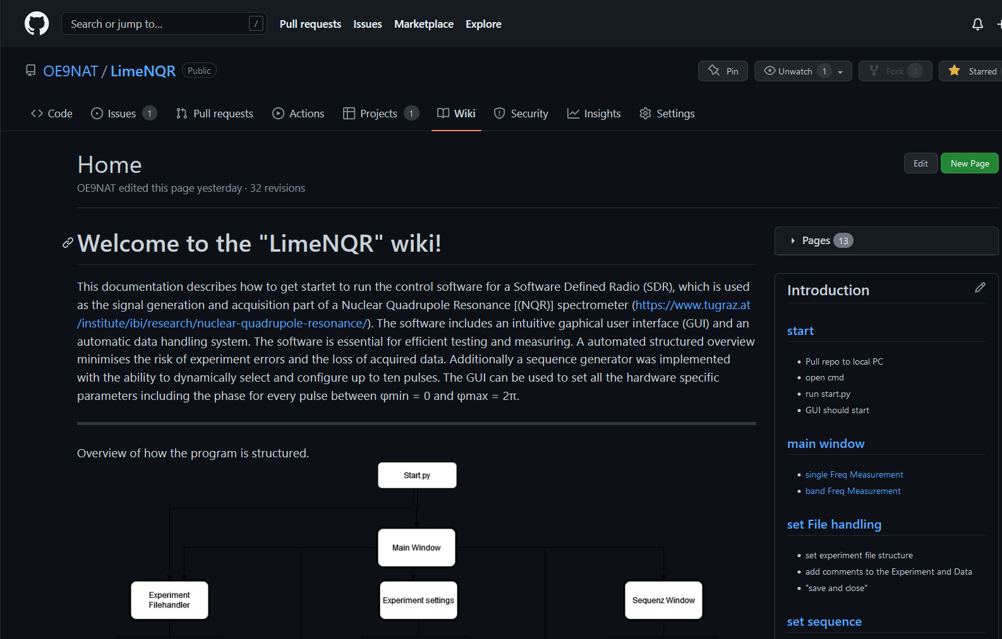
Method :
www.Github.com/oe9nat/LimeNQR/wiki
Notes:
Now coming to the wiki page, all relevant information for the User of the software is stored hear. To the right side, all information is Structured into the relevant Sections and divided to pages with detailed information on “how to”.

Slide 6
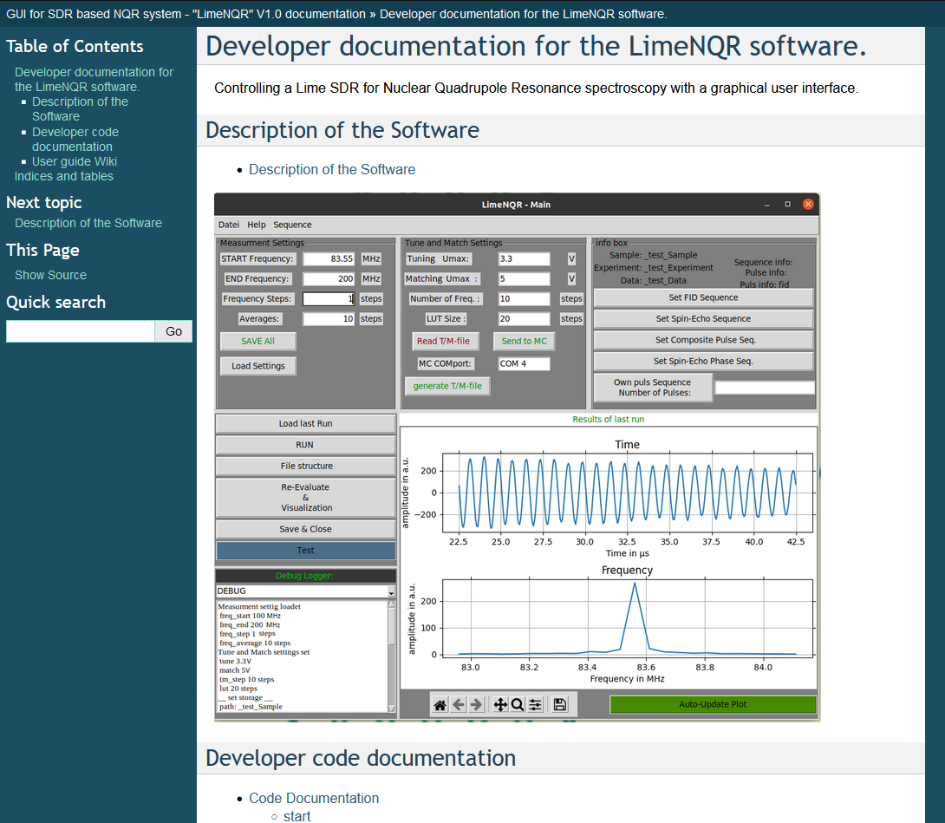
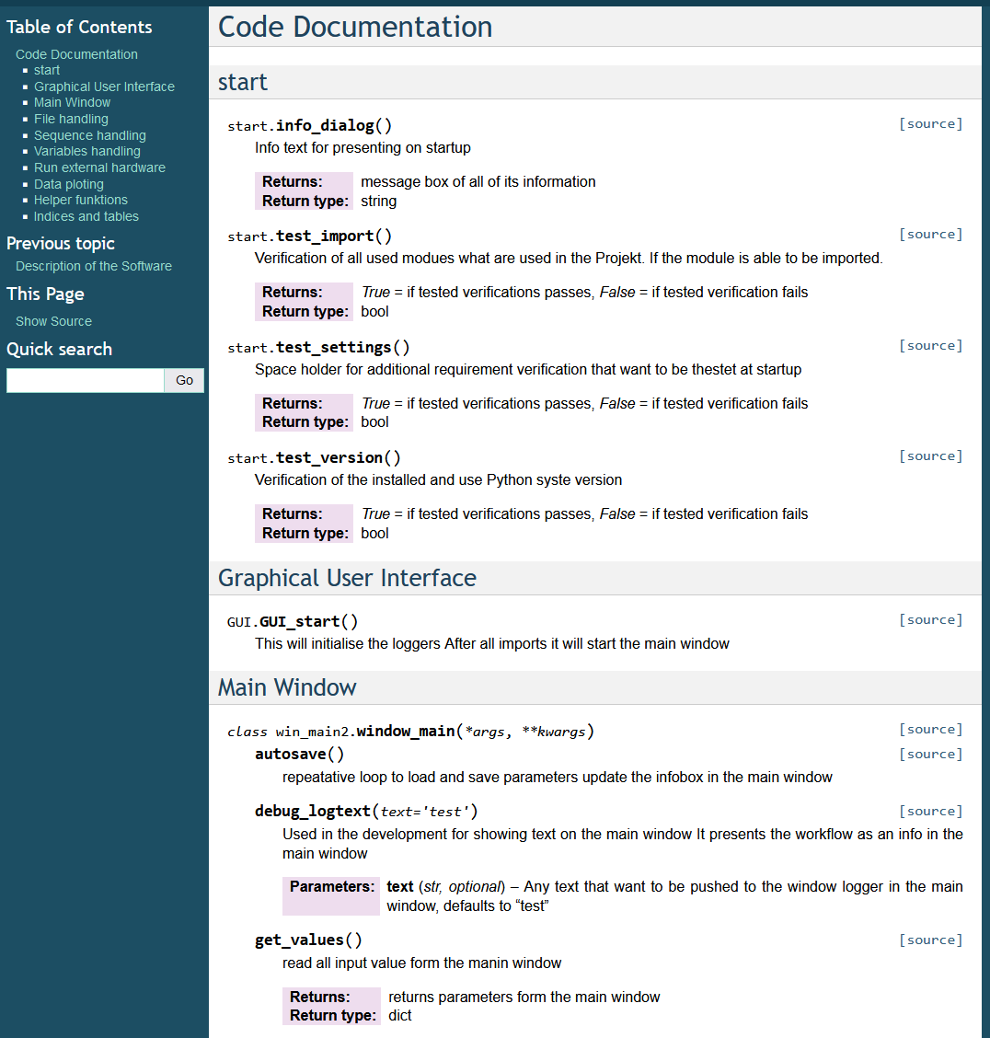

Method :
www.oe9nat.github.io/ LimeNQR/
Notes:
In this additional page, all the documentation for further development was created with the help of Sphinx. It contains additional information on how the software works and is laid out. All description of the classes and functions was placed hear. With the hyperlink “source” to the right you can also look directly into the implementation.

Slide 7
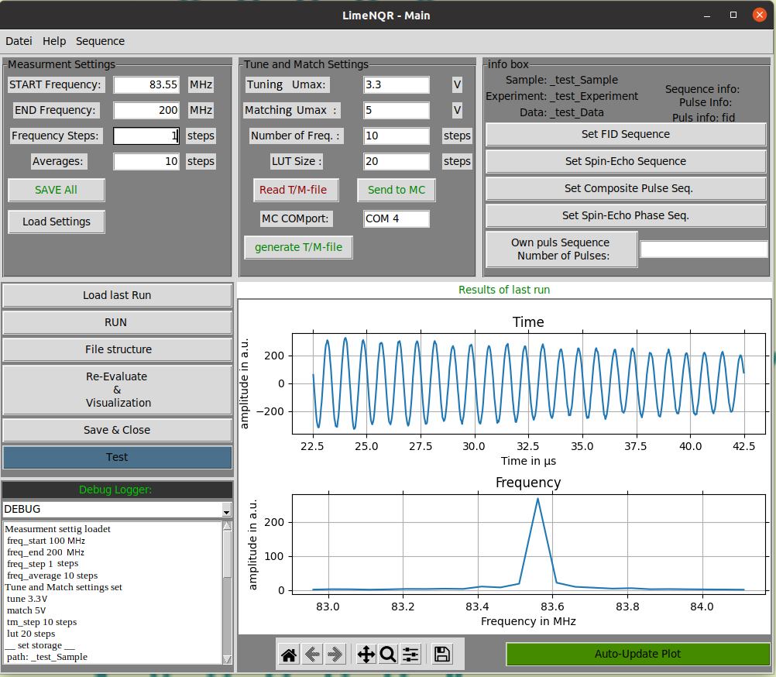
Results :
Main window
Parameter control
Singel freq. measurement
Band freq. measurement
Experiment launch
Evaluation
Notes:
Now comming to the Results:
All Controls will be managed from the main window. # Starting at the left top we see the measurment settings for the sequence. # Following to the right all relevent information for the Tuning and maching setting can be set.
# In the right top corner all selections and information for the sequence are located.
# Below the sequence settings there is a Plotter to show live captured data from running measurments. It periodicaly updates its data from a specific file.
# To the left all Buttens for Controlling of the seqence are placed. In particular, we see the RUN butten which executes the sequenc on the sample.
Below the Buttens we see a debugg logger for monitioring the system.
# Commenting, for singel frequency measurments requires a frequency step sice of smaller or equal to one. Important only the start frequency fill be used.
The software runns only in one thread, therefor only one task after another will be executed.

Slide 8
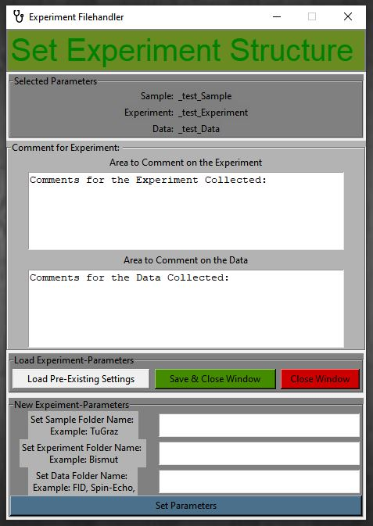
Results :
Experiment Filehandler
Load and save file structure
Add Comments
Generate new file structure
Notes:
In this window the user can generate new storage parameters or load from previous ones. When loading pre-existing settings the user will be Prompted with the file handler to navigate to the settings.cfg file.
Adding, the user can comment on his work at any time, that will appended to a .txt file

Slide 9
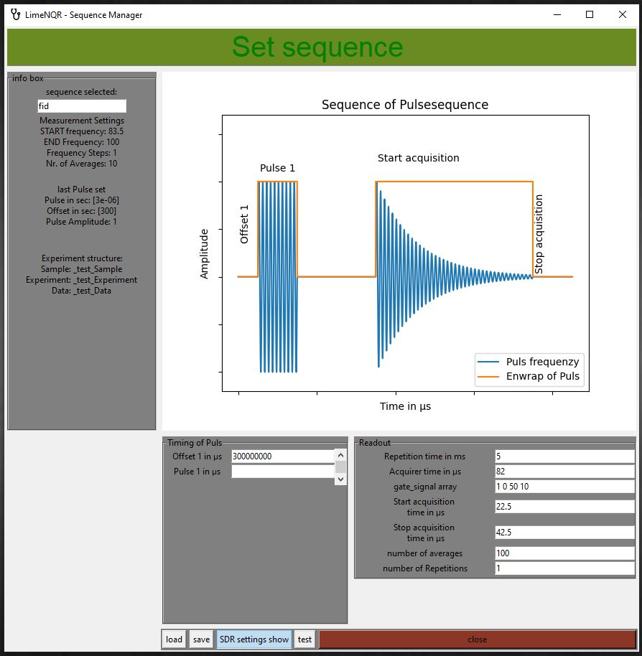
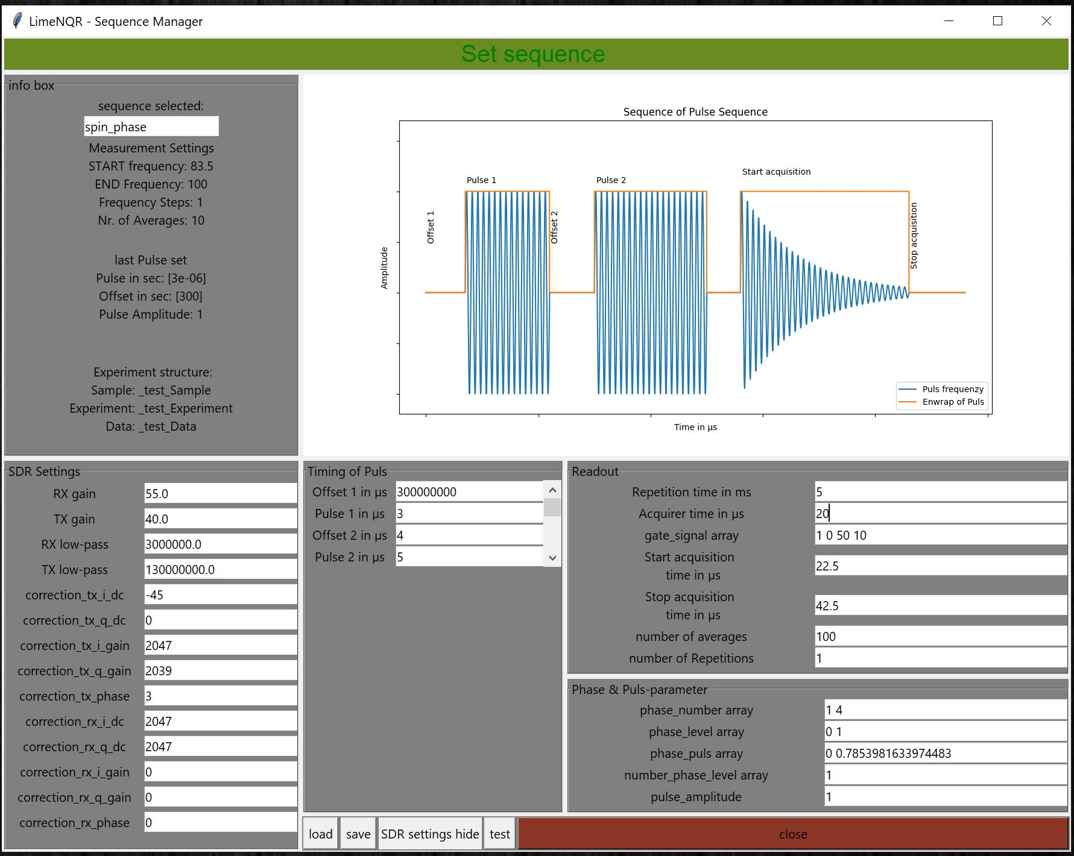
Results :
Set Sequence
FID seq.
Spin-Echo seq.
Composite Pulse
seq.
Spin-Echo Phase
seq.
Notes:
Now to the sequence selection.
Depending on lanching from the main window differen Parameters will be shown dependent on the pre-selections. The Plot will alter itself dependend on the Pulse count. Sections like showing the SDR Setting the user can change itself, but for example the phase setting will be handeled by the software. A maximum Pulse size of 10 Pulses can be set.

Slide 10
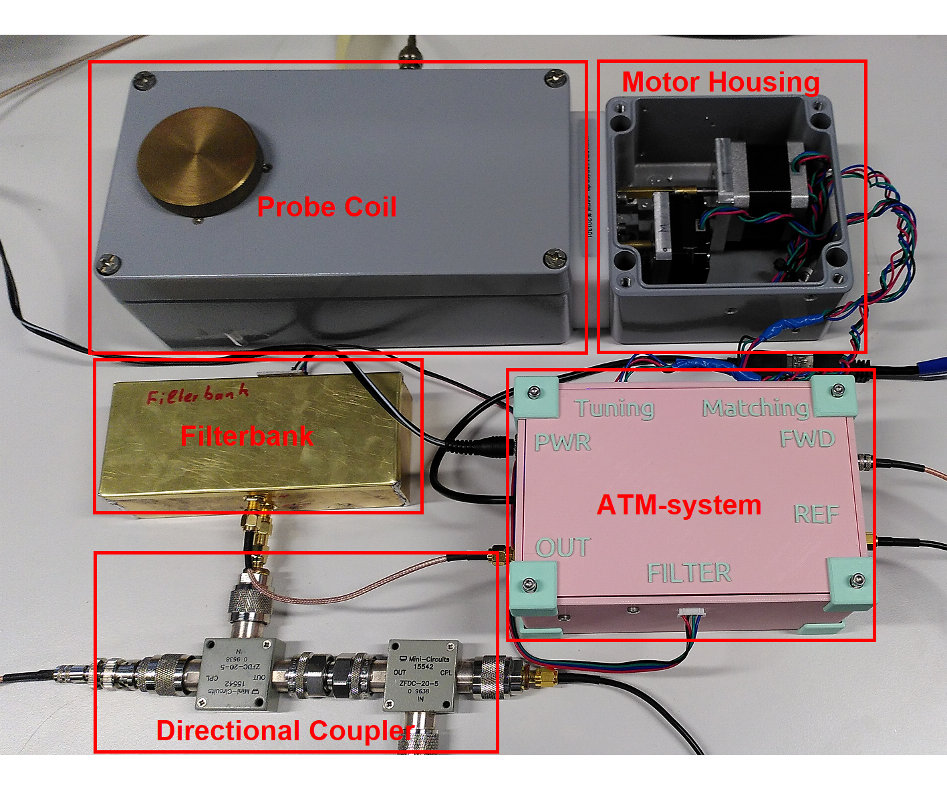
Future work:
Pulse shaping
Automatic Tuning and Matching
Julia Pitzer; https://github.com/jupfi/ATM
Notes:
Thoughts for expention were made sow that Pulse shaping and a automatic tuning and matching system can be easliy implemented in a later state. I can tell that the development of a tuning and matching system has been olready started but was not implemented into the Software.

Slide 11
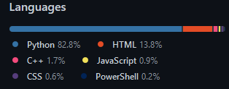
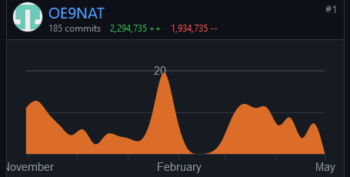
Conclusion
Thank you for your attention!
Lines of code
HTML Sphinx 16 pages + 13 wiki pages
Python 4383 lines of code, 1931 lines of comments
GitHub
first commit on 25.Mai.21
A lot new learned
Notes:
It can be seen, custom developed software is highly specialized to its application. With the continuous development of high capable software, the development will accelerate valid and appreciated findings in the Nuclear Quadrupole Resonance applications.
I hope in the Future that the Projekt will see further developed.
. Thank you for your attention For any Question feel free to ask them now

